Slide 1

Single cell topic Modeling and Multi-omics interpretation of cell topics.
Nilesh Kumar

Slide 2
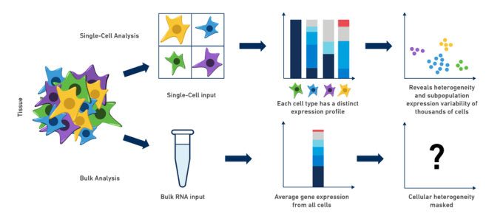

Slide 3
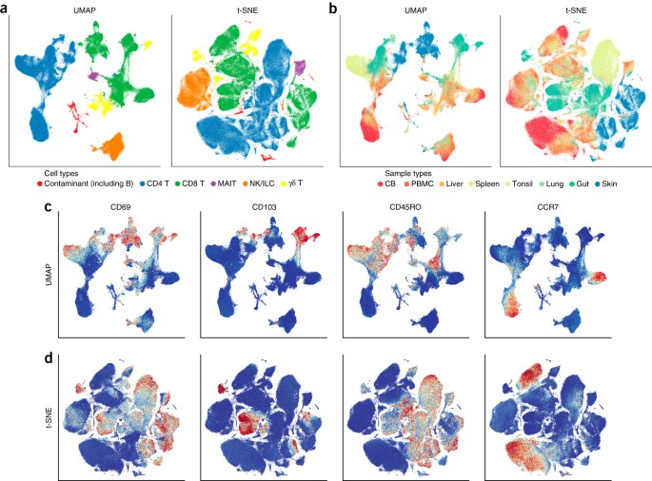

Slide 4
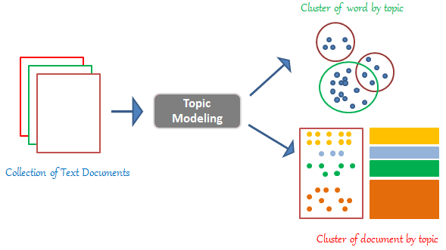
Topic modelling

Slide 5
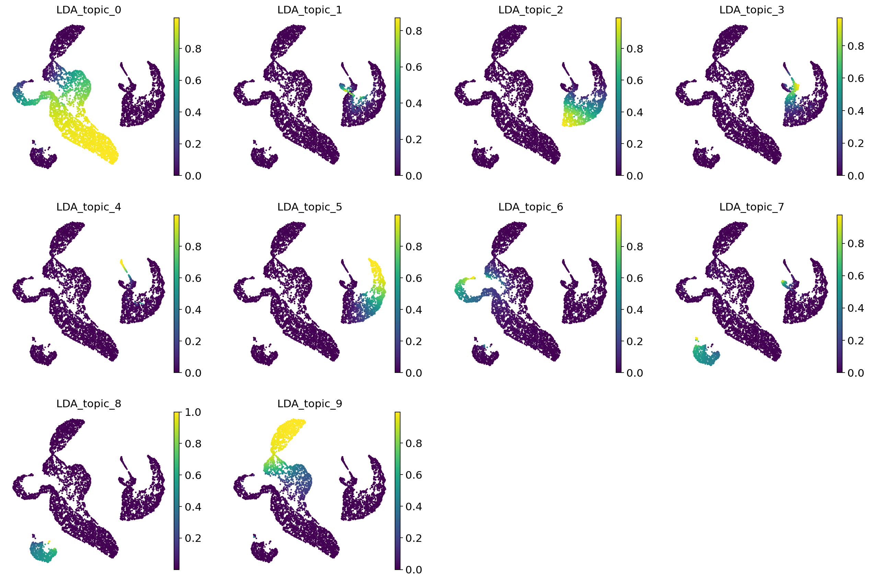
Topic modelling scRNA data

Slide 6
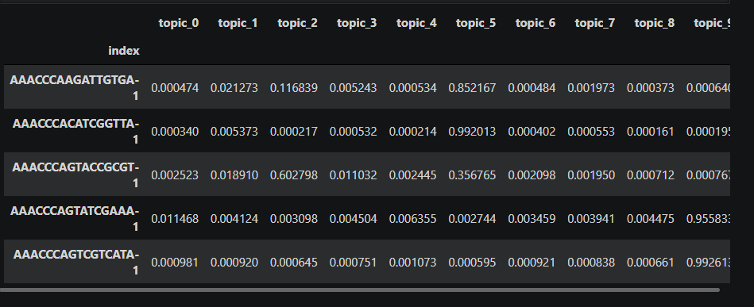
Topic modelling scRNA data

Slide 7
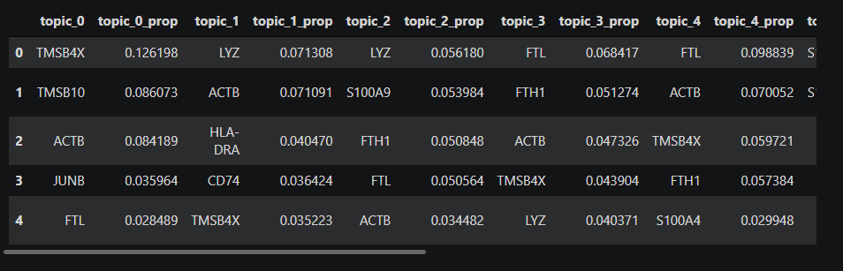
Ranking Genes in each topic

Slide 8
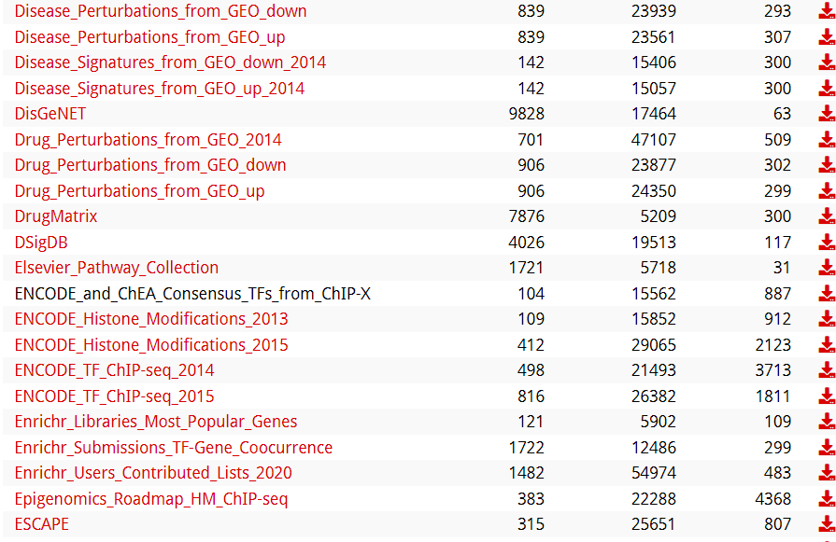
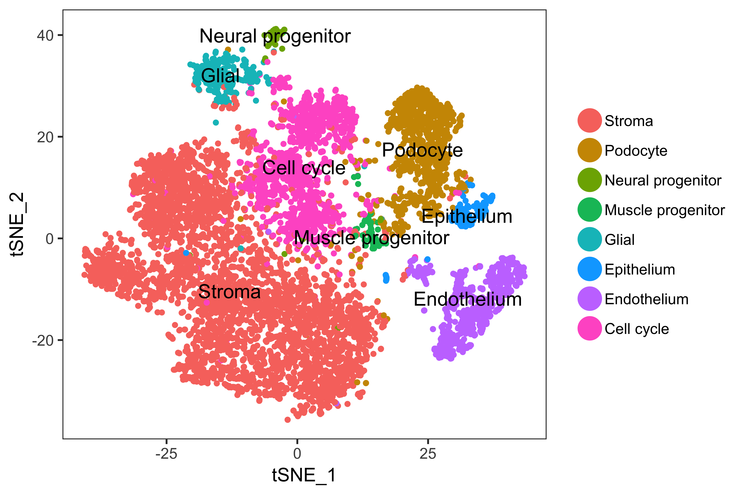
Multiomics Ranked enrichment

